Slide 1

Near Earth Objects Group 2

Slide 2

Agenda
Background
Proposal
Data
Models
Resampled Data
Improve Performance
Classification Report with New Data
SMOTE
Conclusion
Q & A

Slide 3
Background
No manmade objects prior to 1957
Number of satellites has steadily increased
Objects travel in different directions, at different altitudes, on different elliptical planes.
The congestions worsens each year.
Bases of Project
Threat to Earth?
Which objects can harm us?
NASA tracks Nearest Earth Objects
Notes:
Before the launch of Sputnik 1 in 1957, there were no manmade objects in Earth’s orbit.
Number of satellites has steadily increased
Objects traced by U.S. Bombined Space Operations Center’s Space Surveillance Network
Objects travel in different directions, at different altitudes, on different elliptical planes.
The congestions worsens each year.
Infinite number of objects in space.

Slide 4
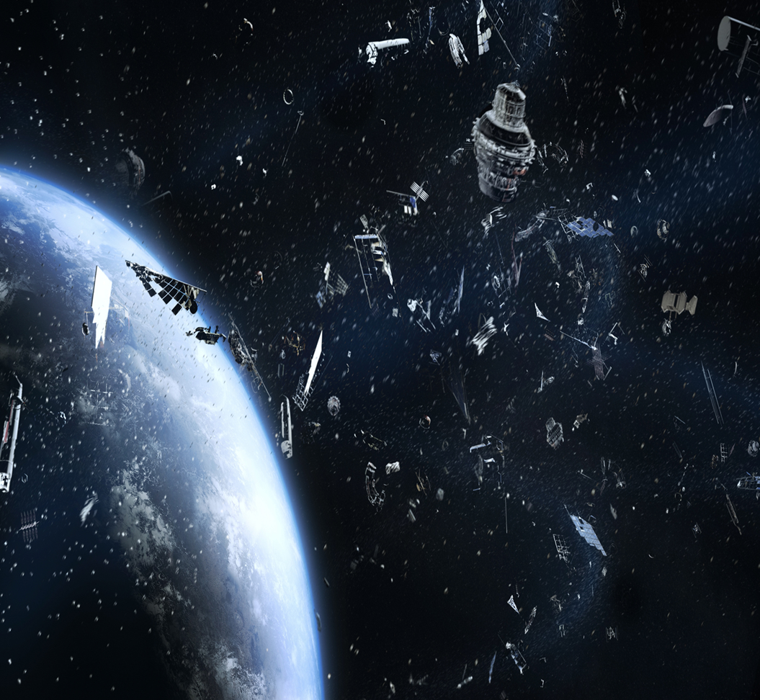
Proposal
Develop a model that can classify whether or not near-Earth objects pose a threat to satellites, disrupts natural phenomena, or is likely to impact Earth.
Utilize data from NASA’s Near-Earth Object (NEO) Web Service for the model creation and testing.
Notes:
7-day period of NEO data pulled from the NASA

Slide 5
Data
Retrieved data from NASA NEOwS API.
Defined the target vector for items that are potentially hazardous:
Data scaling required.
Several models for preliminary evaluation.
Is Potentially Hazardous
0 | 7666
1 | 552

Slide 6
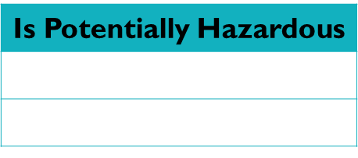
Models
Model Used for Predictions | Train Accuracy | Test Accuracy | Balanced Accuracy Score
SVC- rbf (Standard Scaler) | 0.940 | 0.931
SVC – rbf (Mini Max Scaler) | 0.935 | 0.927
Random Forest (max depth = 3) | 0.9436962518254097 |  | 0.5689501312335958
Suggestion: The model is not great at identifying hazardous asteroids potentially due to the extent to which the data is imbalanced. This false negative could be potentially catastrophic.
Efforts needed to improve model performance at detecting hazardous asteroids.
Resampling needed: Resampled Value Counts

Slide 7
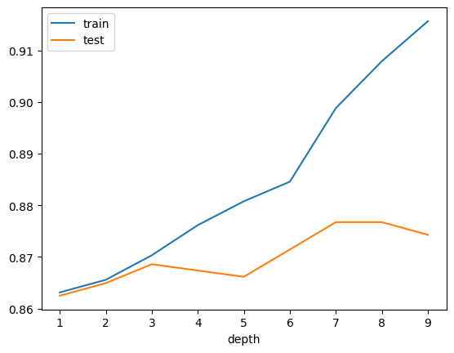
Resampled Data
Classification reports for Random Forest with max_depth of 3 using predictions from resampled model using random_oversampler vs original data.
Original_data
precision recall f1-score support
0 0.94 1.00 0.97 1905
1 0.84 0.14 0.24 150
accuracy 0.94 2055
macro avg 0.89 0.57 0.60 2055
weighted avg 0.93 0.94 0.91 2055
Using random_oversampler
precision recall f1-score support
0 1.00 0.83 0.91 1905
1 0.31 0.99 0.48 150
accuracy 0.84 2055
macro avg 0.66 0.91 0.69 2055
weighted avg 0.95 0.84 0.88 2055

Slide 8
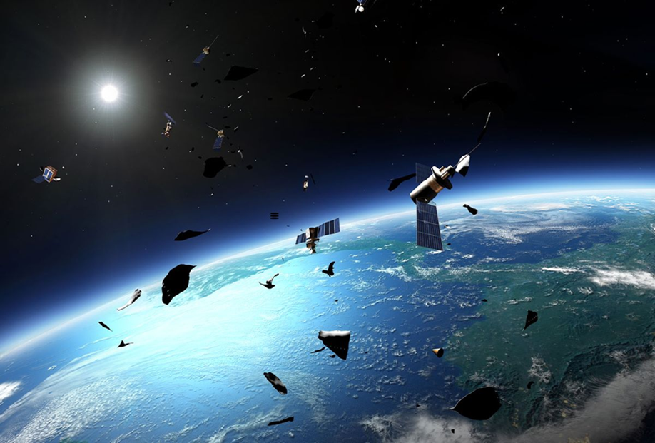
Improve Model Performance
Retrieve more real data from NASA
Modified create_dataset script to get additional records
Created new Random Forest Model
Target value counts with new data:
Is Potentially Hazardous
0 | 7666
1 | 2164

Slide 9
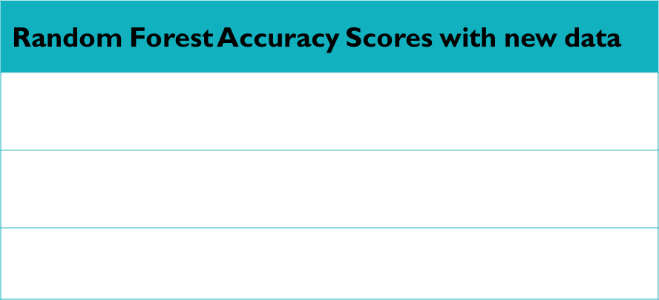
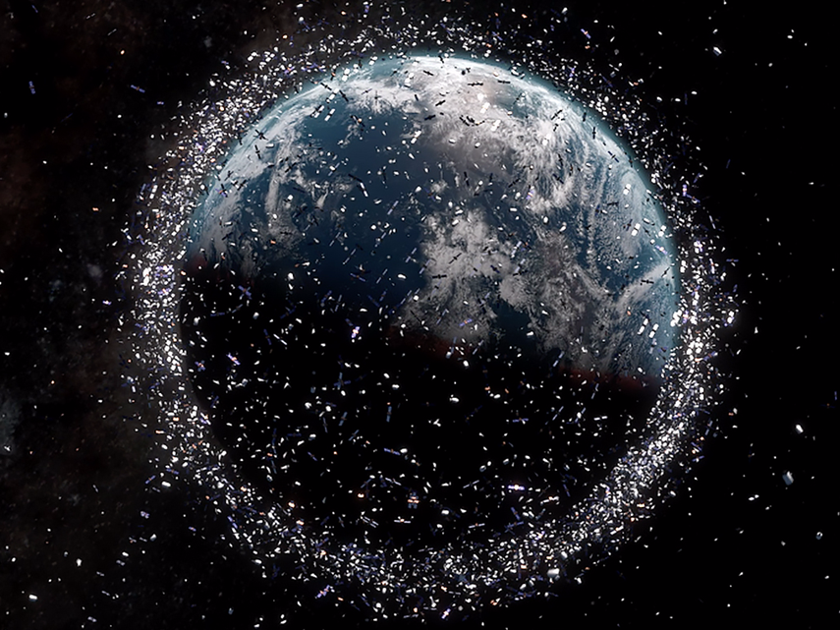
Classification Report with New Data
With new data
precision recall f1-score support
0 0.99 0.83 0.91 1902
1 0.63 0.98 0.77 556
accuracy 0.87 2458
macro avg 0.81 0.91 0.84 2458
weighted avg 0.91 0.87 0.88 2458

Slide 10
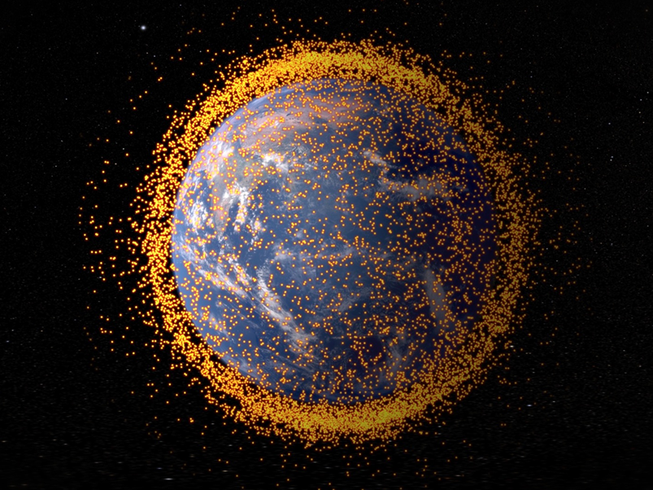
Classification Report with New Data - SMOTE
The Resampled and Added Data - SMOTE model is generally better.
Random Forest Accuracy Scores with new data
Testing data accuracy score: | 0.8991049633848658
Training data accuracy score: | 1.0
Balanced Accuracy Score: | 0.9068038944238931
Classification Report - Resampled and Added Data – SMOTE
precision recall f1-score support
0 0.97 0.89 0.93 1902
1 0.71 0.92 0.80 556
accuracy 0.89 2458
macro avg 0.84 0.90 0.86 2458
weighted avg 0.91 0.89 0.90 2458

Slide 11
Conclusion
Classify whether or not a Near-Earth Object poses a risk.
The chosen model was not great at identifying Hazards
After resampling, the model improved for Class I (hazardous instances) but worsened for Class 0 (negative instances).
Performance was still not were it needed to be, so more data was retrieved from NASA.
Final results: A substantial improvement over the original model
Notes:
Classify whether or not a Near-Earth Object poses a risk.
Several models were evaluated
The chosen model was not great at identifying Hazards
After resampling, the model improved for Class I (hazardous instances) but worsened for Class 0 (negative instances).
Data was resampled again using SMOTE and attempted to improve model performance by retrieving more data
from NASA.
The new data model represented a substantial improvement over the original model in precision, recall, and F1-
Score for Class 1, which is crucial for this application.
It also Provides slightly better overall performance metrics, indicating a more balanced and effective model.

Slide 12

Click similation to show NEO
Note: Provided
by the Astromaterials
Research & Exploration NASA Orbital Debris Program Office
Notes:
The following graphics are computer generated images of objects in Earth orbit that are currently being tracked. Approximately 95% of the objects in this illustration are orbital debris, i.e., not functional satellites. The dots represent the current location of each item.
The orbital debris dots are scaled according to the image size of the graphic to optimize their visibility and are not scaled to Earth. These images provide a good visualization of where the greatest orbital debris populations exist.

Slide 13
Questions

